Slide 1

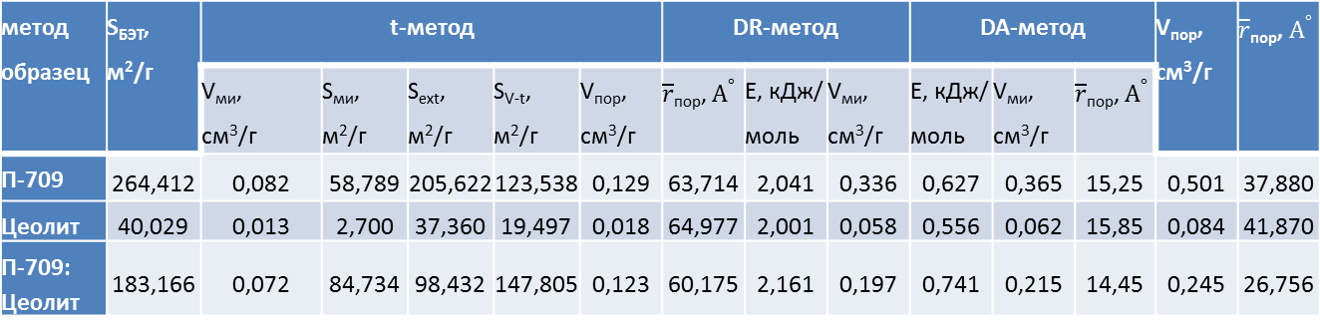
Температурная зависимость сорбции о-ксилола из водных растворов на смешанном углеродно – минеральном адсорбенте
Таблица 1. Параметры образцов по сорбции азота.
V_{ми} – объем микропор, см³/г
S_{ми} – удельная площадь поверхности микропор, м²/г
S_{ext} - удельная площадь внешней поверхности гранул, м²/г
S_{V-t} - удельная поверхность с учетом толщины адсорбционной пленки, м²/г
V_{пор} – полный объем пор, см³/г
$\overline{r}$_{пор} – средний радиус пор, $А^{°}$
Е – энергия адсорбции, кДж/моль
метод образец | S_{БЭТ}, м²/г | t-метод |  |  |  |  | DR-метод |  |  | DA-метод |  |  | V_{пор}, см³/г | $\overline{r}$_{пор}, $А^{°}$
 |  | V_{ми}, см³/г | S_{ми}, м²/г | S_{ext}, м²/г | S_{V-t}, м²/г | V_{пор}, см³/г | $\overline{r}$_{пор}, $А^{°}$ | Е, кДж/ моль | V_{ми}, см³/г | Е, кДж/ моль | V_{ми}, см³/г | $\overline{r}$_{пор}, $А^{°}$
П-709 | 264,412 | 0,082 | 58,789 | 205,622 | 123,538 | 0,129 | 63,714 | 2,041 | 0,336 | 0,627 | 0,365 | 15,25 | 0,501 | 37,880
Цеолит | 40,029 | 0,013 | 2,700 | 37,360 | 19,497 | 0,018 | 64,977 | 2,001 | 0,058 | 0,556 | 0,062 | 15,85 | 0,084 | 41,870
П-709: Цеолит | 183,166 | 0,072 | 84,734 | 98,432 | 147,805 | 0,123 | 60,175 | 2,161 | 0,197 | 0,741 | 0,215 | 14,45 | 0,245 | 26,756

Slide 2
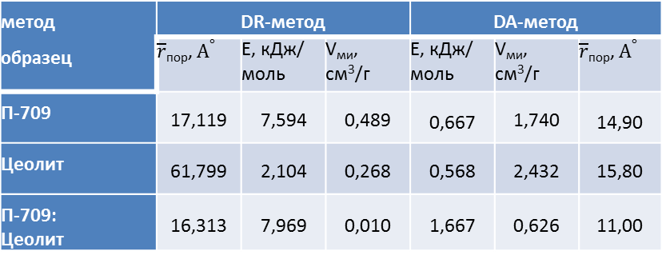
Таблица 2. Параметры образцов по сорбции паров воды.
метод образец | DR-метод |  |  | DA-метод
 |  | Е, кДж/ моль | V_{ми}, см³/г | Е, кДж/ моль | V_{ми}, см³/г
П-709 | 17,119 | 7,594 | 0,489 | 0,667 | 1,740 | 14,90
Цеолит | 61,799 | 2,104 | 0,268 | 0,568 | 2,432 | 15,80
П-709: Цеолит | 16,313 | 7,969 | 0,010 | 1,667 | 0,626 | 11,00

Slide 3
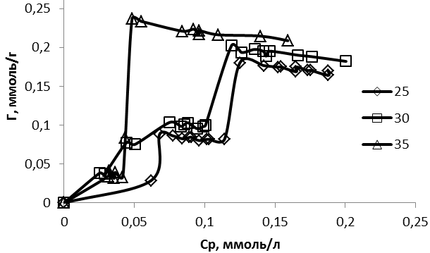
Изотермы адсорбции о – ксилола из водных растворов на смешанном материале при различных температурах (⁰С)

Slide 4
Таблица 3. Коэффициенты достоверности аппроксимации изотерм адсорбции о-ксилола при различных температурах уравнениями.
Температура ⁰С Уравнение | 25 | 30 | 35
Ленгмюр | 0,0176 | 0,3265 | 0,0022
Фрейндлих | 0,7711 | 0,8956 | 0,6654
Дубинин - Радушкевич | 0,7838 | 0,8875 | 0,7112
Таблица 4. Энергии адсорбционного взаимодействия (Дж/моль) при различных температурах
25 ⁰С | 30 ⁰С | 35 ⁰С
4686,357 | 6226,275 | 5167,096

Slide 5
Литература
1. Ting Qiu, Yu Zeng, Changshen Ye, Hui Tian Adsorption Thermodynamics and Kinetics of p-Xylene on Activated Carbon // J. Chem. Eng. Data 2012, 57, 5, 1551–1556; https://doi.org/10.1021/je300138a
2. Ding Wang, Elisabeth McLaughlin, Robert Pfeffer, Y. S. Lin Adsorption of Organic Compounds in Vapor, Liquid, and Aqueous Solution Phases on Hydrophobic Aerogels // Ind. Eng. Chem. Res. 2011, 50, 12177–12185; dx.doi.org/10.1021/ie201301n
3. Letícia F. Lima, Julia R. de Andrade, Meuris G. C. da Silva, Melissa G. A. Vieira Fixed Bed Adsorption of Benzene, Toluene, and Xylene (BTX) Contaminants from Monocomponent and Multicomponent Solutions Using a Commercial Organoclay // Ind. Eng. Chem. Res. 2017, 56, 6326−6336; DOI: 10.1021/acs.iecr.7b00173
4. Fei Yu, Yanqing Wu, Xiaoman Li, Jie Ma Kinetic and Thermodynamic Studies of Toluene, Ethylbenzene, and m‑Xylene Adsorption from Aqueous Solutions onto KOH-Activated Multiwalled Carbon Nanotubes // J. Agric. Food Chem. 2012, 60, 12245−12253; dx.doi.org/10.1021/jf304104z
5. Zhaoyang Qi, Miaomiao Zhou, Ling Li, Ting Qiu, Changshen Ye Selective Adsorption of p‑Xylene from Pure Terephthalic Acid Wastewater on Modified and Formed Zeolites // J. Chem. Eng. Data 2017, 62, 1047−1057; DOI: 10.1021/acs.jced.6b00861
6. Adriana Dervanoski Luz, Selene Maria de Arruda Guelli Ulson de Souza, Cleuzir da Luz, Ricardo Vicente de Paula Rezende, Antô nio Augusto Ulson de Souza Multicomponent Adsorption and Desorption of BTX Compounds Using Coconut Shell Activated Carbon: Experiments, Mathematical Modeling, and Numerical Simulation // Ind. Eng. Chem. Res. 2013, 52, 7896−7911; dx.doi.org/10.1021/ie302849j
7. Changshen Ye, Chongfu Wu, Zhaoyang Qi,Zhixian Huang, Ting Qiu Preparation of a Fe-ZSM‑5 Adsorbent and Its Selective Adsorption of p‑Xylene Performance Exploration // J. Chem. Eng. Data 2020, 65, 2194−2205; https://dx.doi.org/10.1021/acs.jced.0c00054
8. Li-Hui Chen, Xing-Yi Chen, Shuang Song, Shui-Feng Zhang, Yong-Gang Zhao, Yin Lu Preparation of Magnetic Spongy Porous Carbon Skeleton Materials for Efficient Removal of BTEX // Langmuir 2024, 40, 18736−18749; https://doi.org/10.1021/acs.langmuir.4c02465
9. Frederik Vermoortele, Michael Maes, Peyman Z. Moghadam, Matthew J. Lennox, Florence Ragon, Mohammed Boulhout, Shyam Biswas, Katrien G. M. Laurier, Isabelle Beurroies, Renaud Denoyel, Maarten Roeffaers, Norbert Stock, Tina D€uren, Christian Serre, Dirk E. De Vos p-Xylene-Selective MetalOrganic Frameworks: A Case of Topology-Directed Selectivity // J. Am. Chem. Soc. 2011, 133, 18526–18529; dx.doi.org/10.1021/ja207287h
10. Selene Maria de Arruda Guelli Ulson de Souza, Adriana Dervanoski da Luz, Adriano da Silva, Antô nio Augusto Ulson de Souza Removal of Mono- and Multicomponent BTX Compounds from Effluents Using Activated Carbon from Coconut Shell as the Adsorbent // Ind. Eng. Chem. Res. 2012, 51, 6461−6469; dx.doi.org/10.1021/ie2026772
11. Yuxi Yang, Peng Bai, Xianghai Guo Separation of Xylene Isomers: A Review of Recent Advances in Materials // Ind. Eng. Chem. Res. 2017, 56, 14725−14753; DOI: 10.1021/acs.iecr.7b03127

Slide 6
12. Шмелев А.А., Шафигулин Р.В., Буланова А.В. Мезопористый диоксид титана, допированный диспрозием, как эффективный адсорбент некоторых органических поллютантов // Сорбционные и хроматографические процессы. 2021. Т. 21. № 6. С. 833-840
13. Зайцева Ю. М., Смирнова С. С., Маркова Е. Б. Процесс адсорбции орто-ксилола на металлоорганических каркасах на основе 2-аминотерефталатов с самарием, гадолинием и диспрозием // Перспективные материалы и технологии (ПМТ-2025): Сборник докладов Национальной научно-технической конференции с международным участием, Москва, 07–12 апреля 2025 года. – Москва: МИРЭА - Российский технологический университет, 2025. – С. 667-673.
14. Monteiro C., Ventura C., Martins F. A new approach for the extraction of pollutants from wastewaters handled by the graphic industry // Journal of Environmental Management. – 2013. – Vol. 122. – P. 99-104. – DOI 10.1016/j.jenvman.2013.01.039.
15. Abdelhedi R., Bouguerra, M. L. Passivation d'electrodes de platine et d'or lors de l'oxydation electrochimique indirecte du xylene // Electrochimica Acta. – 1990. – Vol. 35, No. 1. – P. 273-279. – DOI 10.1016/0013-4686(90)85070-4.
16. Oleg Pokrovskiy, Irina Rostovschikova, Denis Ovchinnikov Entropy driven separation of xylene isomers on graphitic carbon adsorbents // Journal of Chromatography A, Volume 1716, 2024, 464641, ISSN 0021-9673, https://doi.org/10.1016/j.chroma.2024.464641.
17. Fengsheng Su, Chungsying Lu, Suhkai Hu Adsorption of benzene, toluene, ethylbenzene and p-xylene by NaOCl-oxidized carbon nanotubes // Colloids and Surfaces A: Physicochem. Eng. Aspects 353 (2010) 83–91; doi:10.1016/j.colsurfa.2009.10.025
18. Yingna Chen, Hailong Zhang , Jian Guo, Lu Cai, Yaning Wang, Xinxin Yao , Wendong Song Lili Ji Highly Efficient Adsorption of P-Xylene from Aqueous Solutions by Hierarchical Nanoporous Biochar Derived from Crab Shell // JRM, 2021, vol.9, no.10, р. 1741 -1755; DOI: 10.32604/jrm.2021.015924
19. Teeraya Bureerug, Chidchanok Wannasiri, Supphachok Chanmungkalakul, Mongkol Sukwattanasinitt, Vuthichai Ervithayasuporn, Thanthapatra Bunchuay Crosslinked siloxane–silsesquioxane elastomer with pyrene functionalization for rapid adsorption of benzene, toluene, and xylene (BTX) from water and sensing of charged species // Polym. Chem., 2024, 15, 2981–2991; DOI: 10.1039/d4py00394b
20. Meng Wu , Zening Zhao, Guojun Cai, Caijin Wang, Gongbi Cheng, Xiaokang Wang Adsorption behaviour and mechanism of benzene, toluene and m-xylene (BTX) solution onto kaolinite: Experimental and molecular dynamics simulation studies // Separation and Purification Technology 291 (2022) 120940; https://doi.org/10.1016/j.seppur.2022.120940

Slide 7
21. Tajudeen A. Oyehan, Saheed A. Ganiyu, Christian Pfrang , Marc Walker, Eugenia Valsami - Jones Low cost MXene synthesis for regenerative adsorption of benzene, toluene, ethylbenzene and xylene (BTEX) // Chemical Engineering Journal 492 (2024) 152217; https://doi.org/10.1016/j.cej.2024.152217
22. Changshen Ye , Ping Lu , Xianwei Jiang , Chongfu Wu , Ting Qiu, Yi Li Synthesis and adsorption behavior of a magnetic ZSM zeolite for the selective removal of p-xylene from complex aqueous media // Chemical Engineering & Processing: Process Intensification 153 (2020) 107961; https://doi.org/10.1016/j.cep.2020.107961
23. Cícero P. Moura, Carla B. Vidal, Allen L. Barros, Luelc S. Costa, Luiz C.G. Vasconcellos, Francisco S. Dias, Ronaldo F. Nascimento Adsorption of BTX (benzene, toluene, o-xylene, and p-xylene) from aqueous solutions by modified periodic mesoporous organosilica // Journal of Colloid and Interface Science 363 (2011) 626–634; doi:10.1016/j.jcis.2011.07.054
24. Fei Yu, Jie Ma, Yanqing Wu Adsorption of toluene, ethylbenzene and m-xylene on multi-walled carbon nanotubes with different oxygen contents from aqueous solutions // Journal of Hazardous Materials 192 (2011) 1370–1379; doi:10.1016/j.jhazmat.2011.06.048
25. S.M. Yakout, A.A.M. Daifullah Adsorption of toluene, ethylbenzene and xylenes by activated carbon-impact of molecular oxygen // Desalination and Water Treatment 52 (2014) 4977–4981; doi: 10.1080/19443994.2013.821028
26. Avideh Azizi, Ali Torabian, Elham Moniri, Amir Hessam Hassani, Homayon Ahmad Panahi Adsorption performance of modified graphene oxide nanoparticles for the removal of toluene, ethylbenzene, and xylenes from aqueous solution // Desalination and Water Treatment 57 (2016) 28806–28821; https://doi.org/10.1080/19443994.2016.1193769
27. Fei Yu, Yanqing Wu, Jie Ma Influence of the pore structure and surface chemistry on adsorption of ethylbenzene and xylene isomers by KOH-activated multi-walled carbon nanotubes // Journal of Hazardous Materials 237–238 (2012) 102–109; http://dx.doi.org/10.1016/j.jhazmat.2012.07.059
28. Hirra Anjum, Khairiraihanna Johari, Nirmala Gnanasundaram, Arunagiri Appusamy, Murugesan Thanabalan Investigation of green functionalization of multiwall carbon nanotubes and its application in adsorption of benzene, toluene & pxylene from aqueous solution // Journal of Cleaner Production 221 (2019) 323 – 338; https://doi.org/10.1016/j.jclepro.2019.02.233
29. Avideh Azizi, Ali Torabian, Elham Moniri, Amir Hessam Hassani, Homayon Ahmad Panahi Novel synthesis of graphene oxide with polystyrene for the adsorption of toluene, ethylbenzene and xylenes from wastewater // Desalination and Water Treatment 74 (2017) 248–257; doi: 10.5004/dwt.2017.20585
30. Kashi Banerjee, Paul N. Cheremisinoff, Su Ling Cheng Adsorption kinetics of o-xylene by flyash // Wat. Res. 1997, Vol. 31, No. 2, pp. 249-261
31. Ching-Ju Monica Chin, Li-Chieh Shih, Hen-Je Tsai, Ta-Kang Liu Adsorption of o-xylene and p-xylene from water by SWCNTs // Carbon 45 (2007) 1254–1260; doi:10.1016/j.carbon.2007.01.015
32. Johnson Nune Naat, Muhammad Luqman Hakim, Irene Arliana Yuanita, Nuryono Nuryono, Erliza Hambali, Satya Candra Wibawa Sakti, Mochamad Zakki Fahmi, Yessi Permana Hydrophobic modification of silica-coated magnetic iron sand with MTES, PTES, and HDTMS for enhanced adsorption of benzene, toluene, and xylene // Next Materials 10 (2026) 101461; https://doi.org/10.1016/j.nxmate.2025.101461

Slide 8
33. Reyaz A. Kango, James G. Quinn Adsorption studies of xylenes and ethylbenzene on soil and humic acid by a purge and trap gas chromatographic method // Chemosphere, 1989, Vol.19, Nos.8/9, pp 1269-1276
34. Nitai C. Maji, Niket S. Kaisare, Madivala G. Basavaraj Titania stabilized Pickering emulsion for photocatalytic degradation of o-xylene // Colloids and Surfaces A: Physicochemical and Engineering Aspects 705 (2025) 135534; https://doi.org/10.1016/j.colsurfa.2024.135534
35. Цветнов М.А., Моргун Н.П., Кондриков Н.Б. Исследование сорбционных свойств смешанного углеродно – минерального материала // Материалы международной научно-практической конференции МАТЕРИАЛОВЕДЕНИЕ, ФОРМООБРАЗУЮЩИЕ ТЕХНОЛОГИИ И ОБОРУДОВАНИЕ 2023 (ICMSSTE 2023) ЯЛТА 16 – 19 мая 2023 г., Симферополь, 2023, с. 18 -25.; https://elibrary.ru/item.asp?id=54225134&pff=1
Работа выполнена по теме Научного совета РАН по физической химии: 2.15.2.У 2.15.3.Ц 25-03-460-10 V.2, V.3

