Slide 1
Study of modification of carbon univariate nanostructures
with impurity boron atoms
I Zaporotskova¹ N Boroznina¹ S Boroznin¹
¹ Volgograd State University, Volgograd, Russia

Slide 2
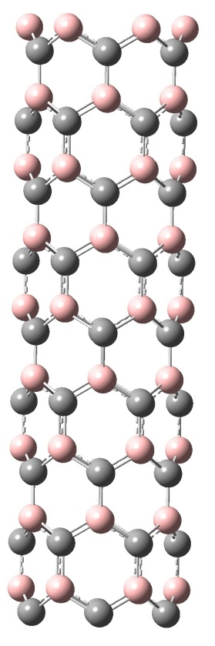
Structural features and basic energy characteristics of BC nanotubes of type (n, 0) were studied, when in the structure of a carbon nanotube every second carbon atom is replaced by a boron atom.
Table 1. Main characteristics of boron-containing nanotubes (n, 0). Calculations of ΔEg were carried out using the DFT method using functionality B3LYP
(n, 0) | ΔEg, eV (ВС)
(4, 0) | 0,02
(6, 0) | 0,09
(8, 0) | 0,02
(10, 0) | 0,02
(12, 0) | 0,02

Slide 3
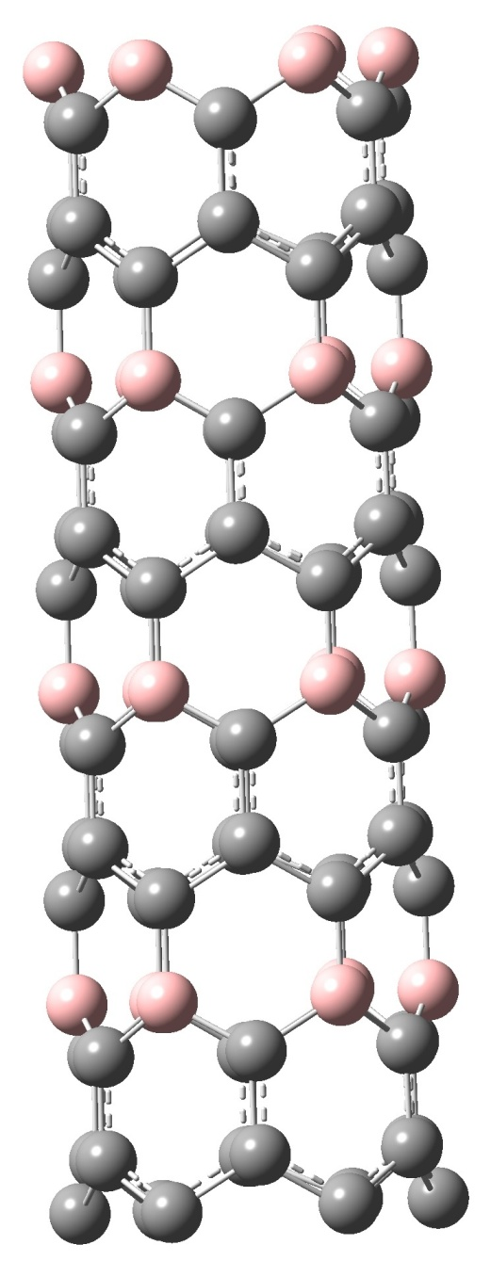
Next, carbon nanotubes were studied, in which only one atom out of six in the carbon hexagon was replaced with boron. These are the so-called VS5 nanotubes. Figure 2 shows a cluster of such a nanotube type (6, 0).
Table 2. Width of forbidden slot for REI of single-layer BC5 nanotubes (n, n).
(n, 0) | ΔEg, eV (ВС₅)
(4, 0) | 0,13
(6, 0) | 0,69
(8, 0) | 0,26
(10, 0) | 0,19
(12, 0) | 0,69

Slide 4
Analysis of the data showed that single-layer BC5 nanotubes are narrow-gap semiconductors. Dependence of forbidden zone width on nanotubes is periodic. Graphs of the band gap width versus nantubes diameter were plotted.

Slide 5
The comparison of the effect of the concentration of impurity boron atoms on the conductive state of the nanotubes obtained from the analysis of the calculated values of the width ΔEg showed the following.
Table 3. Dependence of band gap width for boron-containing nanotubes and pure carbon nanotubes on diameter.
Nanotube diameter, Å | ΔEg, eV (ВС₅) | ΔEg, eV (ВС)
(4, 0) | 0,13 | 0,02
(6, 0) | 0,69 | 0,09
(8, 0) | 0,26 | 0,02
(10, 0) | 0,19 | 0,02
(12, 0) | 0,69 | 0,02

Slide 6
Conclusion
Analysis showed that nanotubes of type (n, n) are dielectrics, and boron-containing nanotubes of type (n, 0) are narrow-gap semiconductors. At the same time, if the concentration of impurity boron atoms is less than 25%, the width of the forbidden zone increases. This can be explained by the presence of inhomogeneities in the charge distribution on the surface of the boron-containing nanotube, since boron atoms accumulate positive charges near themselves, while the electron density is concentrated in carbon atoms. At the same time, when the equilibrium concentration of boron and carbon atoms is reached, the width of the band gap decreases, which becomes practically zero. Thus, the main conclusion of the analysis of the variation of the band gap of carbon nanotubes with impurity boron atoms is the theoretically proven possibility of controlling the conductivity of nanotubes.
Acknowledgment
This study came with the financial support of the grant of the President of the Russian Federation No. 798.2019.1 and the grant of the President of the Russian Federation No. MK-1758.2020.8 agreement 075-15-2020-422 from 16.03.2020

Slide 7
Thank you for your attention

