Slide 1
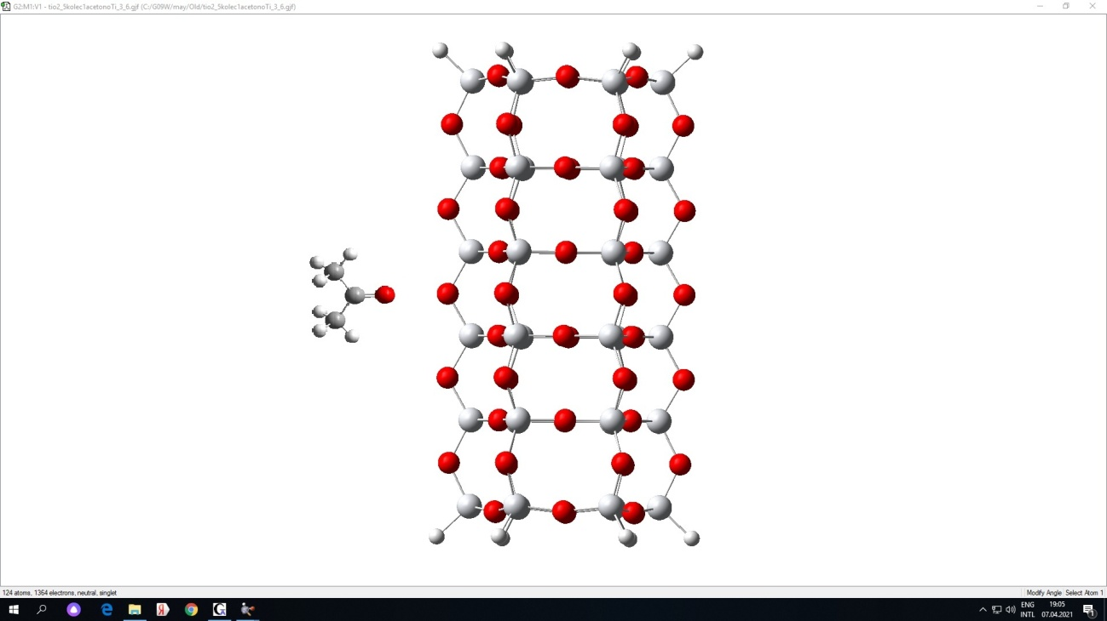
Sensor activity of titanium dioxide nanotubes in relation to acetone molecules
V. Zaporotskova, D. E. Vilkeeva and L. S. Elbakyan
Volgograd State University

Slide 2
Titanium dioxide nanotubes
Nanotubes made of titanium dioxide are actively studied by scientists around the world. This is due to the possibility of their use in many areas of medicine, electronic engineering and nanoelectronics, the creation of filters and portable sensors of a new generation. The interest is primarily due to the relative ease and variability of creating such structures, as well as useful properties, such as high photocatalytic and sensory activity, biocompatibility, etc.
However, to date, inexpensive portable gas sensors for breath analysis, especially for clinical diagnostics and monitoring, have not been developed, which can be an alternative to the complex spectrometric systems used. This work is devoted to the study of sensory interaction an acetone molecule with the surface of titanium dioxide nanotubes. It can be used in devices for analyzing exhaled air and will contribute to the development of diagnostic technologies in medicine.

Slide 3


Methods
Theoretical calculations were carried out using one of the most common research methods - density functional theory (DFT), described by Koch and Holthausen, using the molecular cluster model.
According to Density Functional Theory, the properties of a many-electron system including energy, can be defined by using an electron density functional. The system is described by electronic density as:
Function is defined in all space. The integral from electronic density on all space gives full number of electrons. Kinetic energy of electrons is described obviously in approach of independent particles, a classical part of potential energy is described on Coulomb's law. Exchange and electronic correlation are considered approximately.
Electronic correlation – the effect caused by instant Coulomb repulsion between electrons. Its account results in lower value of total energy of a system. The specified effect is not considered in Hartree-Fock's method. The energy change caused by these instant Coulomb interactions is called energy of correlation:
In general, DFT has an excellent ratio of accuracy and computing expenses that allow using this method for solving a huge number of problems of a quantum-chemical research.

Slide 4
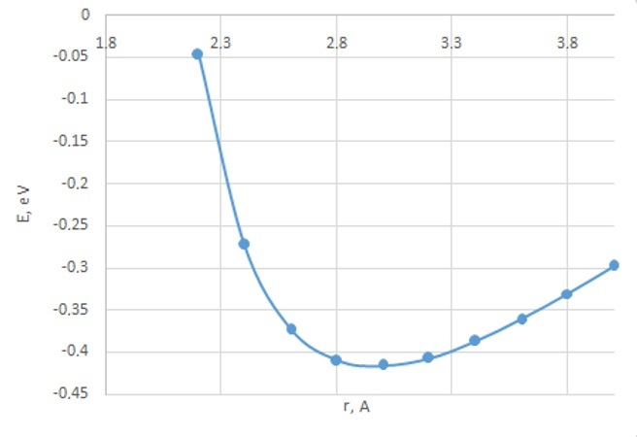
Results and Discussion
Sensory activity to the side surface of the titanium dioxide nanotube in relation to the acetone molecule.
We selected a cluster of three-layer TiO₂ nanotubes of type (6,0), with a diameter of 7 Å, whose open boundaries were closed by pseudoatoms, which were chosen as hydrogen atoms. Modeling of the interaction of a nanotube with an acetone molecule was carried out by step-by-step approximation of the C₃H₆O molecule to the oxygen atom of the tube surface located in the middle of the cluster, along the perpendicular to the longitudinal axis of the TiO₂ tubulene. The acetone molecule was oriented to the surface by an oxygen.
As a result of the calculations, the surface profile of the potential energy of the system "TiO₂ + C₃H₆O nanotube" was constructed.
The energy curve has a minimum at a distance of 3 Å, and the interaction energy is -0.4 eV. This indicates the possibility of an interaction between a titanium dioxide (TiO₂) nanotube and an acetone (C₃H₆O) molecule, which can be called physical adsorption.

Slide 5
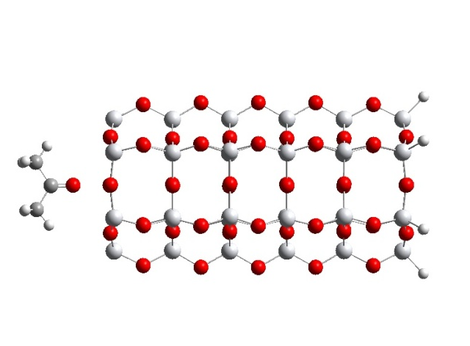
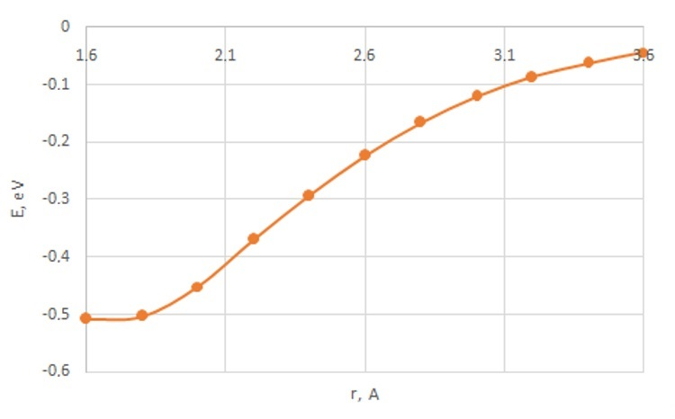
Results and Discussion
Sensory activity to the end surface of the titanium dioxide nanotube in relation to the acetone molecule.
To study the sorption interaction of the end surface of a titanium dioxide nanotube with an acetone (C₃H₆O) molecule, a molecular cluster of a semi-infinite nanotube was considered, one boundary of which remained open, and the broken bonds at the second boundary were closed by hydrogen pseudoatoms. The interaction was modeled by step-by-step approximation of the acetone molecule to the oxygen atom at the open boundary of the nanotube oriented by the oxygen atom along a straight line parallel to the longitudinal axis of the tube.
The calculations made it possible to construct an energy interaction curve.
In this case, the characteristic energy minimum was not detected, which indicates the absence of sensory sensitivity of the end of the titanium dioxide nanotube to the acetone molecule.

Slide 6
Conclusion
Theoretical studies of the interaction of titanium dioxide nanotubes with an acetone molecule have proved the possibility of creating highly sensitive sensors. These sensors can be used for non-invasive diagnostics of human diseases by analyzing the exhaled air. For example, for the diagnosis of diabetes mellitus.
Nanotubes based on titanium dioxide can be chemical and biological sensors that can detect micro-quantities of a substance. The specified interaction geometry will ensure high accuracy and selectivity of the detection of acetone in a complex mixture of gases, vapors and other volatile organic compounds present in the exhaled air. Taking into account these features of functioning, it is worth noting the importance of creating a device with a sensor based on titanium dioxide nanotubes for non-contact diagnosis of diabetes mellitus.
Thank you for your attention!

