Slide 1
Metal salicylates Co²⁺, Zn²⁺, Ni²⁺, Mn²⁺, Li⁺ and Mg²⁺: properties and effect on pain sensitivity
International Scientific Practical Conference «Materials science,
shape-generating technologies and equipment 2021»
(ICMSSTE 2021)
M Yu Ravaeva ^{1*}, I V Cheretaev ¹ and E N Chuyan ¹
¹ Taurida Academy, Faculty of Biology and Chemistry, V.I. Vernadsky Crimean Federal University,
Simferopol, Republic of Crimea, Russia

Slide 2
Introduction
Acetylsalicylic acid (ASA) has been used for many years not only as a universal analgesic, antipyretic and anti-inflammatory agent, but also as a unique source for the production of a wide coordination compounds variety, allowing the synthesis of new derivatives with complexing metals and various biologically active molecules and ligands. The new compounds based on ASA obtained in this way are devoid of its negative side effects and are successfully used as antitumor, anti-inflammatory and antimicrobial substances.
Positive results of studies ASA derivatives biological effectiveness suggest that complexation based on divalent metals and salicylates is promising [4], since such derivatives with bimetals (Fe, Zn, Co, Cu, etc.) have fewer side effects and more pronounced effects than standard aspirin.
In this regard, the aim of this study was to identify the analgesic effects of salicylates (AS) Co²⁺, Zn²⁺, Ni²⁺, Mn²⁺, Li⁺ and Mg²⁺ on the thresholds of pain sensitivity (PS) in rats.

Slide 3
Material and methods
The experiments were performed on male Wistar laboratory rats weighing 200-250 g. They were divided into 22 groups of 7 individuals each.
Group 1 – control (K) – male rats received intraperitoneal (i. p.) injections of 0.2 ml of saline solution (0.9 % NaCl) and were in standard vivarium conditions.
Groups 2-4 – male rats received i. p. injections of 0.2 ml ASA in doses of 5, 10 and 20 mg/kg;
Groups 5-7 – male rats received i. p. injections of 0.2 ml cobalt salicylate (ASCo2+) in doses of 5, 10 and 20 mg/kg;
Groups 8-10 – male rats received i. p. injections of 0.2 ml nickel salicylate (ASNi2+) in doses of 5, 10 and 20 mg/kg;
Groups 11-13 – male rats received i. p. injections of 0.2 ml zinc salicylate (ASZn2+) in doses of 5, 10 and 20 mg/kg;
Groups 14-16 – male rats received i. p. injections of 0.2 ml manganese salicylate (ASMn2+) in doses of 5, 10 and 20 mg/kg;
Groups 17-19 – male rats received i. p. injections of 0.2 ml magnesium salicylate (ASMg2+) in doses of 5, 10 and 20 mg/kg;
Groups 20-22 – male rats received i. p. injections of 0.2 ml lithium salicylate (ASLi+) in doses of 5, 10 and 20 mg/kg.
Testing of PS thresholds in rats was performed 20 minutes after injection in the “tail-flick” and “hot plate” models of acute pain stress. Before the “tail-flick” test, animals were placed in special retainers for rats (AE1001-R0, Open Science, Russia).

Slide 4
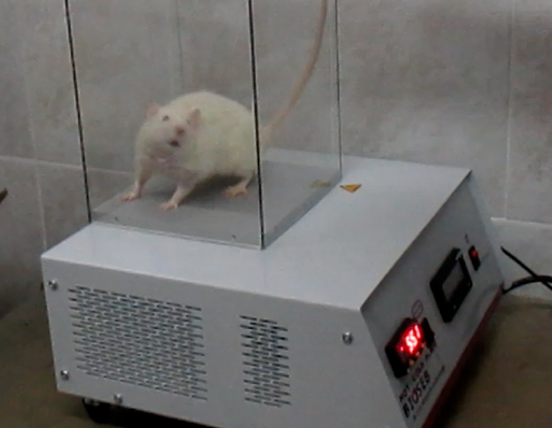
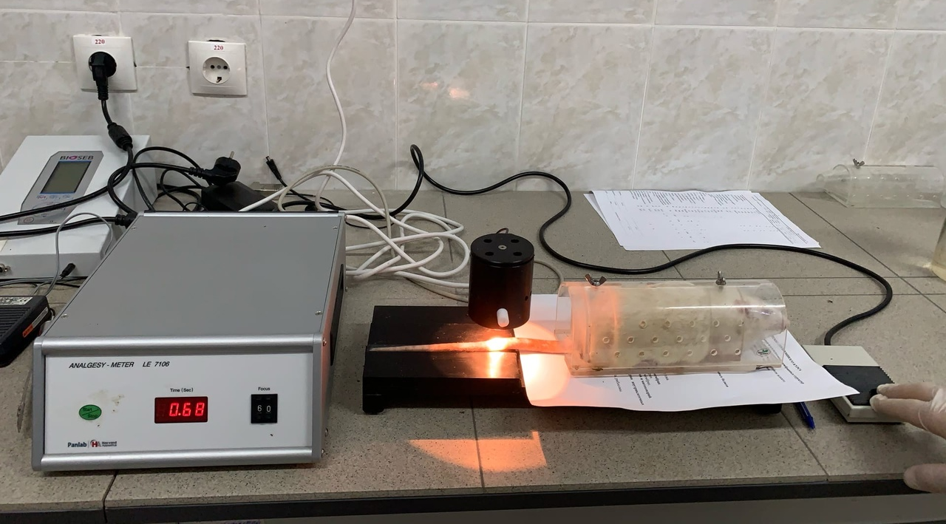
«Tail-flick»
In the “tail-flick” test evaluated the perceptual component of pain. The main indicator of this test was the tail-flick latency (TFL) in response to light-thermal irritation. TFL was determined by the value of the time (s) of the tail withdrawal reaction. TFL was measured on the device LE7106 Tail-flick Meter (Pan Lab Harvard Apparatus, Spain). On the tail of each rat, sitting in the fixator, three presentations of a thermal stimulus were performed, followed by the calculation of the average value of TFL in seconds for each animal. This test is based on a spinal flexor reflex that occurs in response to a local force on the tail by high temperature, and allows us to judge the PS of animals mainly at the spinal level.
«Hot plate»
In the “hot plate” test on experimental apparatus Cold and hot plate CHP (Bioseb, France), the hot-plate test latency (HPTL) of the animal was recorded, which was determined by the value of the time (s) of the reaction manifestation of withdrawal and licking of the limbs and (or) vocalization from the heated surface. The test allows to judge the PS of animals with the participation of supraspinal mechanisms.

Slide 5
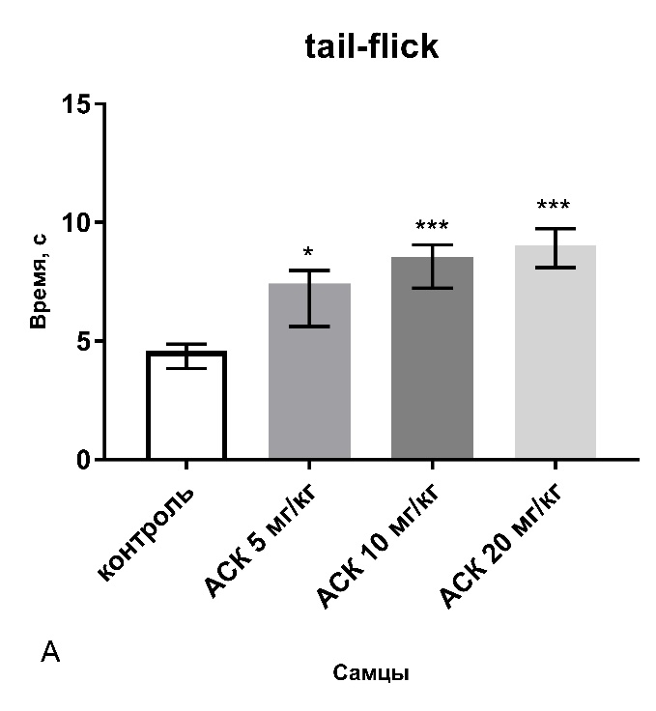
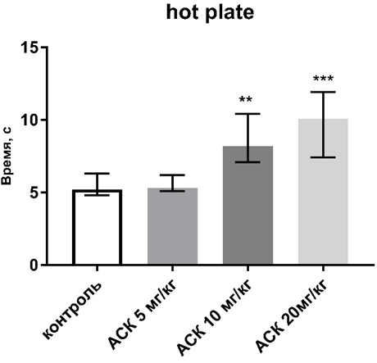
The effect of acetylsalicylic acid at doses of 5 mg / kg, 10 mg / kg and 20 mg / kg on the pain sensitivity of rats in the «tail-flick» and «hot plate» tests
Note: * - p≤0.05; ** - p≤0.01; *** - p≤0.001 - the reliability of the differences in the indicator compared to the control

Slide 6
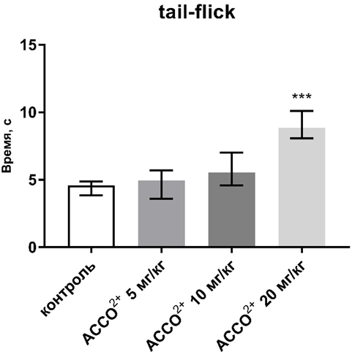
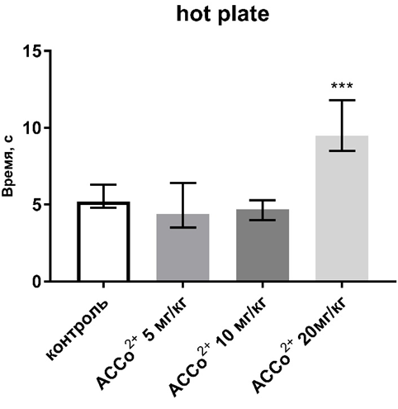
Influence of salicylate Сo ²⁺ on indicators of pain sensitivity in rats in the tail-flick and hot plate tests
Note: * - p≤0.05; ** - p≤0.01; *** - p≤0.001 - the reliability of the differences in the indicator compared to the control

Slide 7
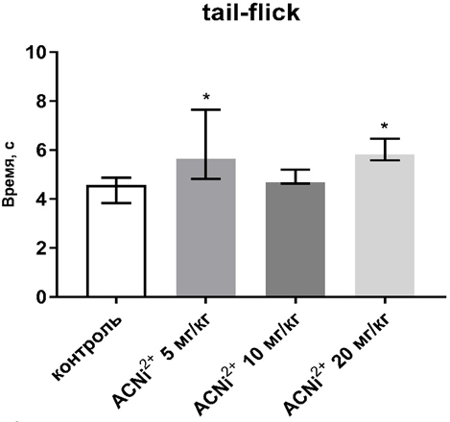
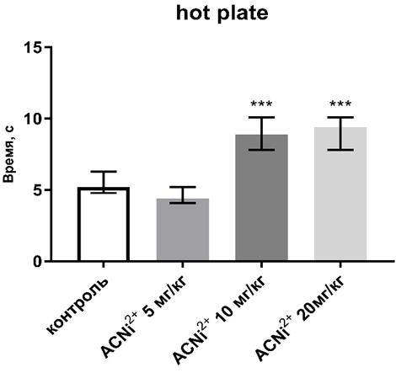
Influence of salicylate Ni ²⁺ on indicators of pain sensitivity of rats in the tail-flick and hot plate tests
Note: * - p≤0.05; ** - p≤0.01; *** - p≤0.001 - the reliability of the differences in the indicator compared to the control

Slide 8
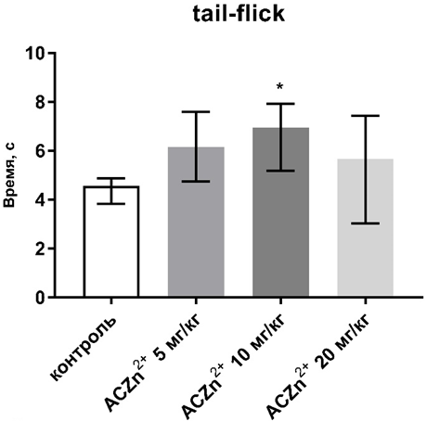
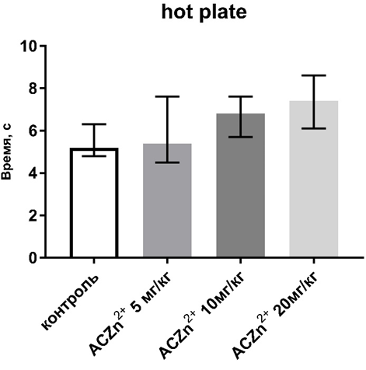
The effect of Zn ²⁺ salicylate on the pain sensitivity of rats in the tail-flick and hot plate tests
Note: * - p≤0.05; ** - p≤0.01; *** - p≤0.001 - the reliability of the differences in the indicator compared to the control

Slide 9
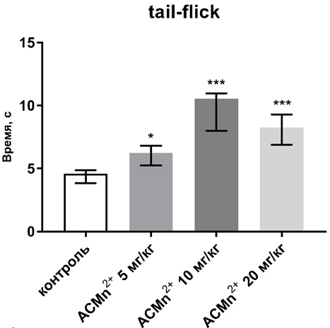
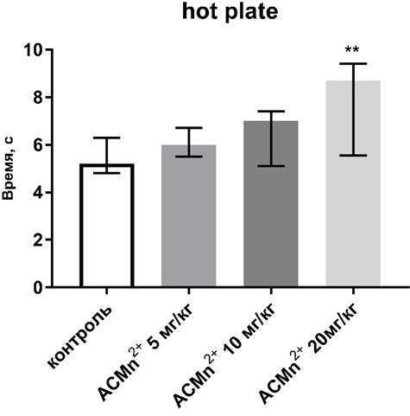
The effect of Mn²⁺ salicylate on the pain sensitivity of rats in the tail-flick and hot plate tests
Note: * - p≤0.05; ** - p≤0.01; *** - p≤0.001 - the reliability of the differences in the indicator compared to the control

Slide 10
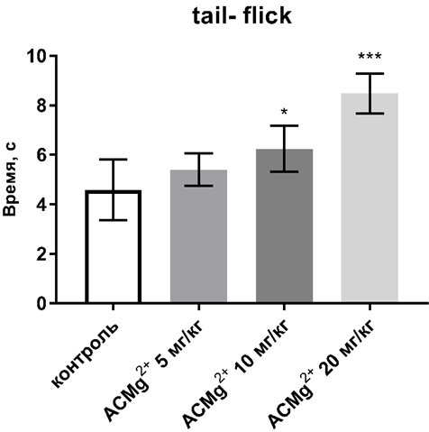
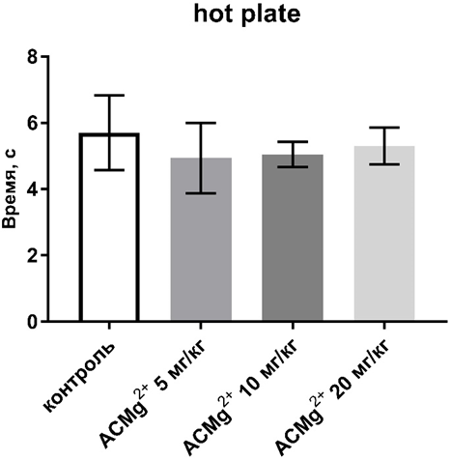
The effect of Mg²⁺ salicylate on the pain sensitivity of rats in the tail-flick and hot plate tests
Note: * - p≤0.05; ** - p≤0.01; *** - p≤0.001 - the reliability of the differences in the indicator compared to the control

Slide 11
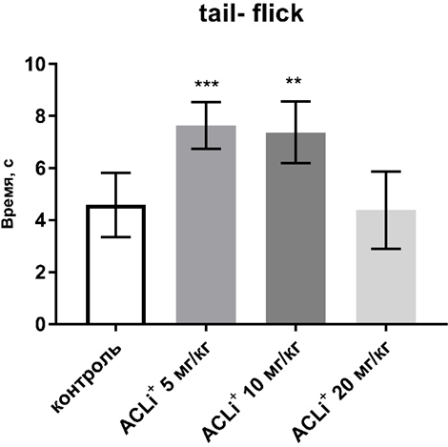
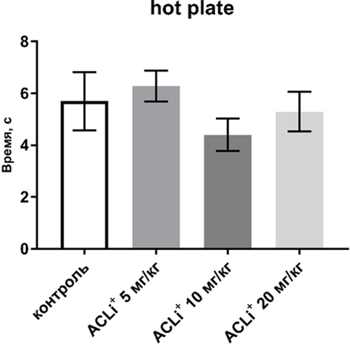
The effect of Li+ salicylate on the pain sensitivity of rats in the tail-flick and hot plate tests
Note: * - p≤0.05; ** - p≤0.01; *** - p≤0.001 - the reliability of the differences in the indicator compared to the control

Slide 12
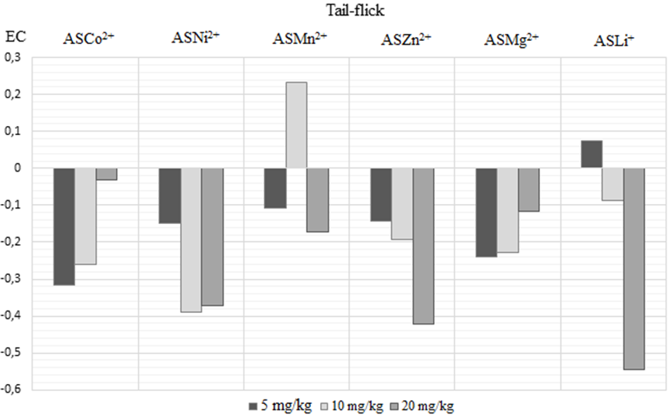
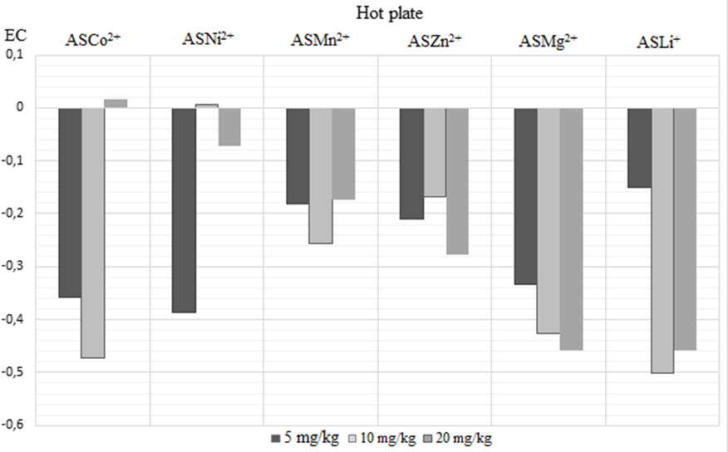
Efficiency coefficient (EC) of analgesic action of salicylates Co²⁺, Ni²⁺, Zn²⁺, Mn²⁺, Mg²⁺ and Li⁺ in the “tail-flick” “hot plate” test

Slide 13
Conclusion
1. ASA in all doses had a pronounced analgesic effect with the participation of spinal and/or supraspinal mechanisms of PS regulation. This is evidenced by a significant increase in the PS thresholds in the tests of thermal acute pain “tail-flick” and “hot plate”.
2. The analgesic effects АSNi²⁺, АSМn²⁺and АSLi⁺ were manifested when this compounds were administered in all three doses, ASMg ²⁺ – at doses of 10 and 20 mg/kg, ASZn²⁺ – only at a dose of 10 mg/kg, ASCo²⁺ – only at a dose of 20 mg/kg.
3. The introduction of metal-complexing agents in ASA molecules reduces their analgesic properties, and the design of connections is not appropriate when creating potent analgesics.

